Slide 1
Software Architecture & Design Introduction

Slide 2
The architecture of a system describes its major components, their relationships (structures), and how they interact with each other. Software architecture and design includes several contributory factors such as Business strategy, quality attributes, human dynamics, design, and IT environment.

Slide 3
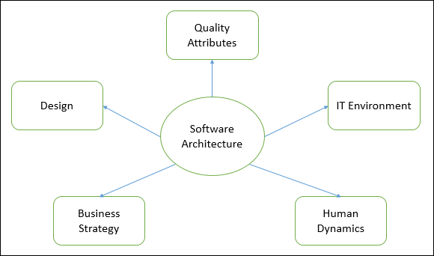

Slide 4
We can segregate Software Architecture and Design into two distinct phases:
Software Architecture and Software Design.
In Architecture, nonfunctional decisions are cast and separated by the functional requirements. In Design, functional requirements are accomplished.

Slide 5
Software Architecture
Architecture serves as a blueprint for a system. It provides an abstraction to manage the system complexity and establish a communication and coordination mechanism among components.
It defines a structured solution to meet all the technical and operational requirements, while optimizing the common quality attributes like performance and security

Slide 6
Decisions in architecture
Further, it involves a set of significant decisions about the organization related to software development and each of these decisions can have a considerable impact on quality,
maintainability,
performance, and the overall success of the final product.
These decisions comprise of
Selection of structural elements and their interfaces by which the system is composed.
Behavior as specified in collaborations among those elements.
Composition of these structural and behavioral elements into large subsystem.
Architectural decisions align with business objectives.
Architectural styles guide the organization.

